Slide 1



DIGITAL TRANSFORMATION & DATA ANALYSIS
Understanding the Risks and Best Practices

Slide 2

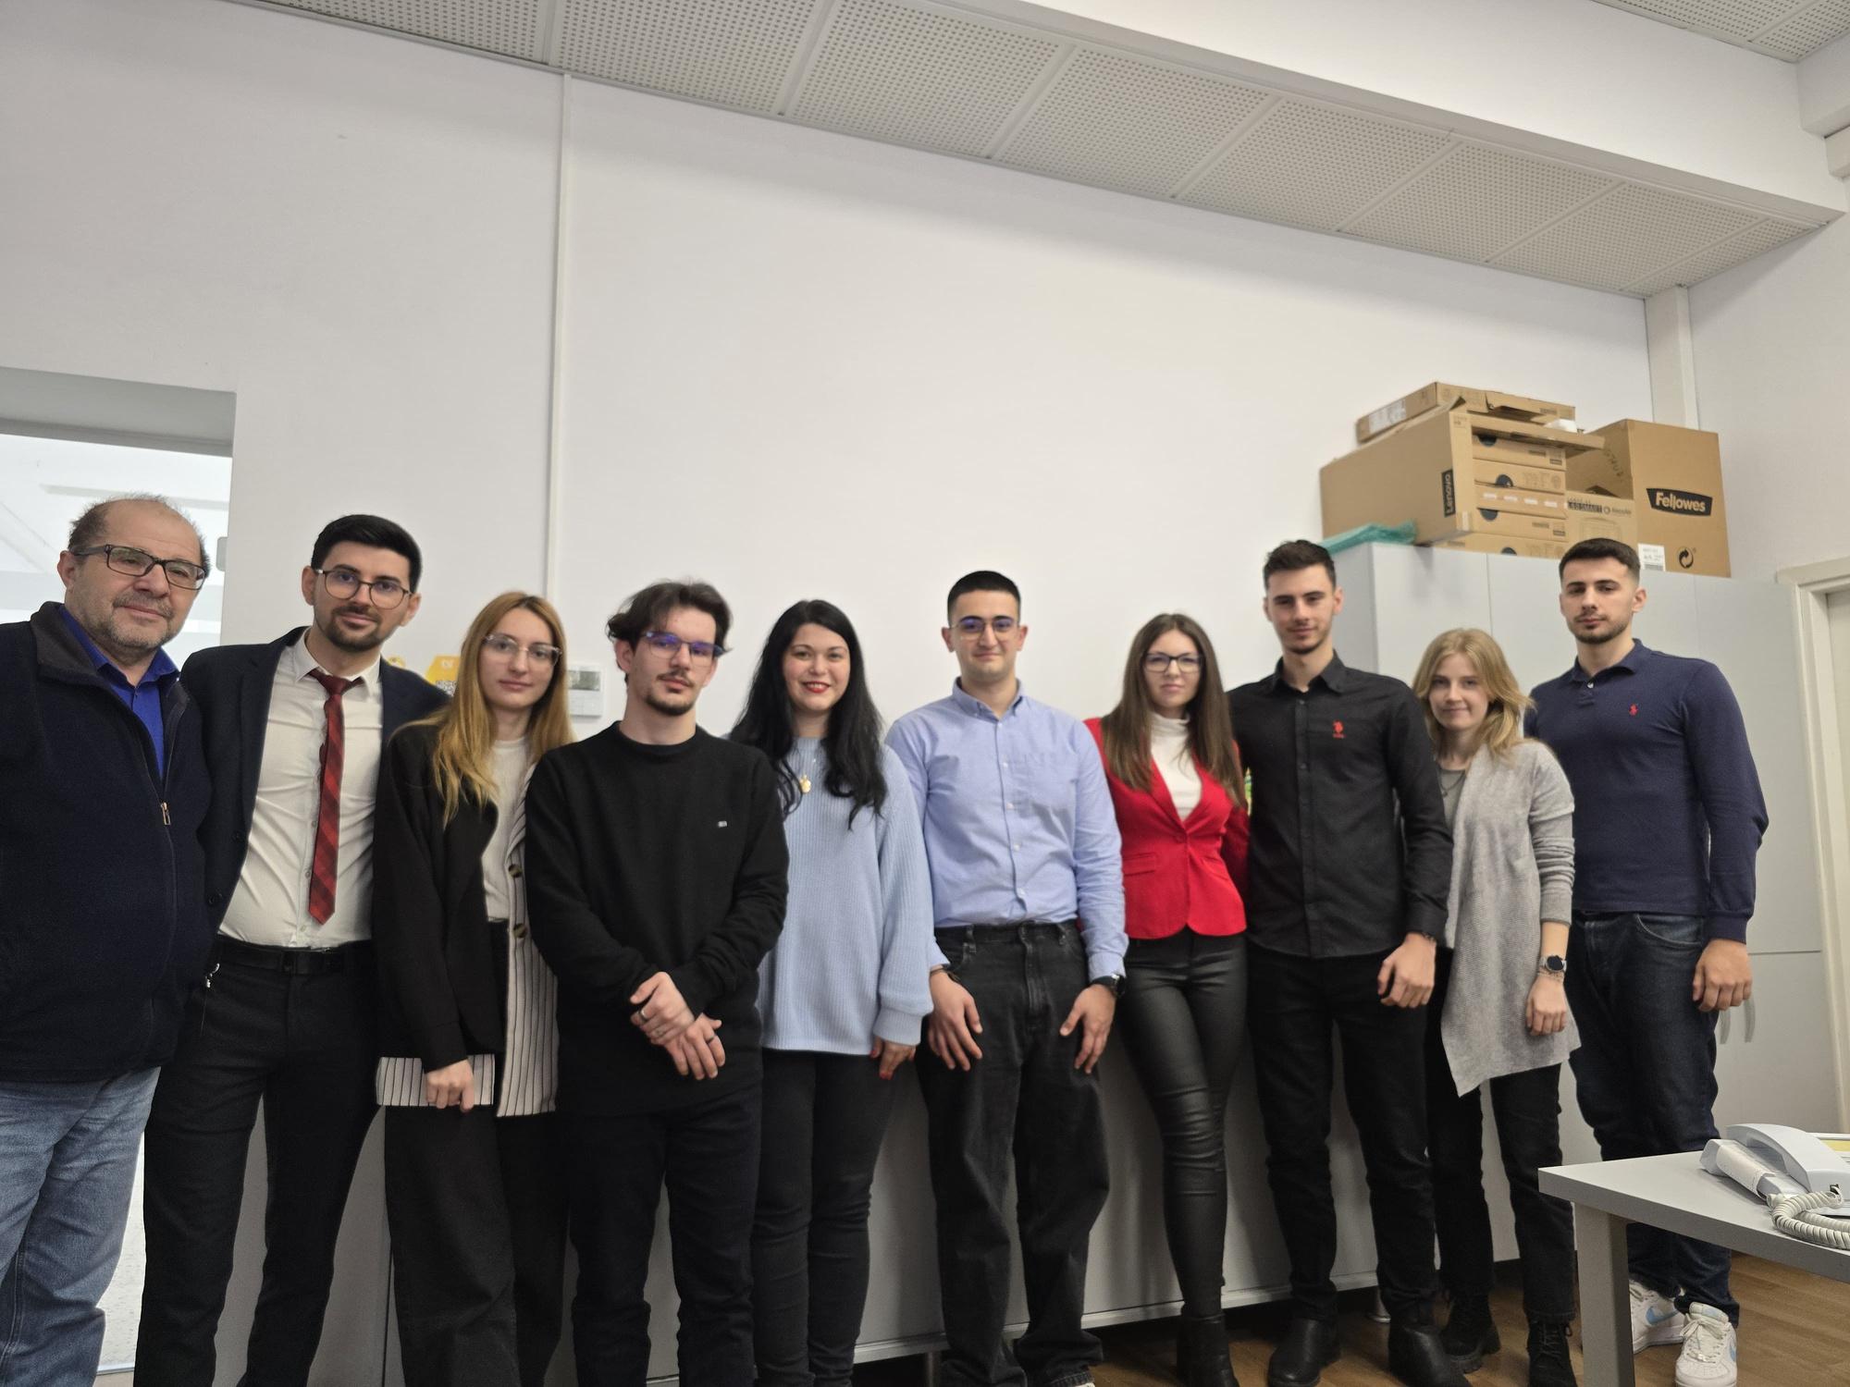
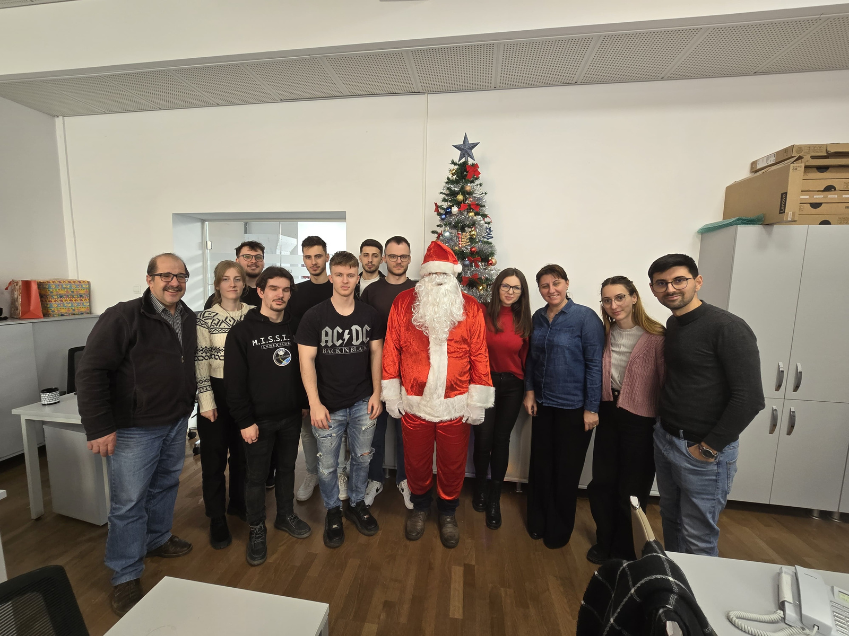


WHO WE ARE
TWO SERVICES, ONE TEAM
Data Analysis
Software Development

Slide 3

SERVICE #1
SOFTWARE DEVELOPMENT
What We Do:
Build & maintain 200+ UVT websites:
Main UVT site, Admissions portal, Faculties websites, project pages…
Custom apps & integrations for admin processes

Slide 4








TECH STACK

Slide 5





SECURITY
Security plugins
Two-factor authentication
Use strong, unique passwords
Enable two-factor authentication (2FA)
GDPR compliance
Monitoring
Regularly update software and apps
Be cautious with personal information online

Slide 6


SERVICE #2
DATA ANALYSIS & SUPPORT
ACTIVITITES:
Technical support (helpdesk tickets)
Automated report generation (contracts, admissions data)
Data management for student & faculty databases
TOOLS & PLATFORMS
Office & Reporting: Excel, Helpdesk platform
Core University Systems: UMS, Webcon DMS, Accommodation platform

Slide 7

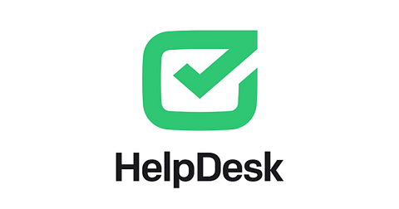


LATEST ACHIEVEMENTS
Rebuilt all faculty websites
9,000+ Helpdesk tickets closed during ‘23 - ‘24
Launched new Intranet with Keycloak SSO
Rolled out 2-step authentication against phishing spikes
First in Romania… 100% digital contract signing for study agreements

Slide 8



WHAT’S NEXT?
Automate remaining paperwork processes
AI-powered chatbot across faculty sites
AI-driven support-ticket resolution
Further strengthen our digital security

Slide 9

Q&A

Slide 10

THANK YOU!

